Slide 1
Linearized Pitch-Axis Attitude Control of a Rocket Using State Feedback and Observer Design
By: Blaine Swieder and Dakota Moye

Slide 2
Introduction
Goal: Regulate Pitch Angle of a launch vehicle around an upright operating point.
Use a linearized two state model (pitch angle θ and pitch rate q) with Thrust-Vector Control (TVC).
Analyze stability, eigenstructure, controllability, and observability.
Validate performance with MATLAB simulations for step response, actuator limits, disturbance rejection, and +/- 10% parameter variations.

Slide 3
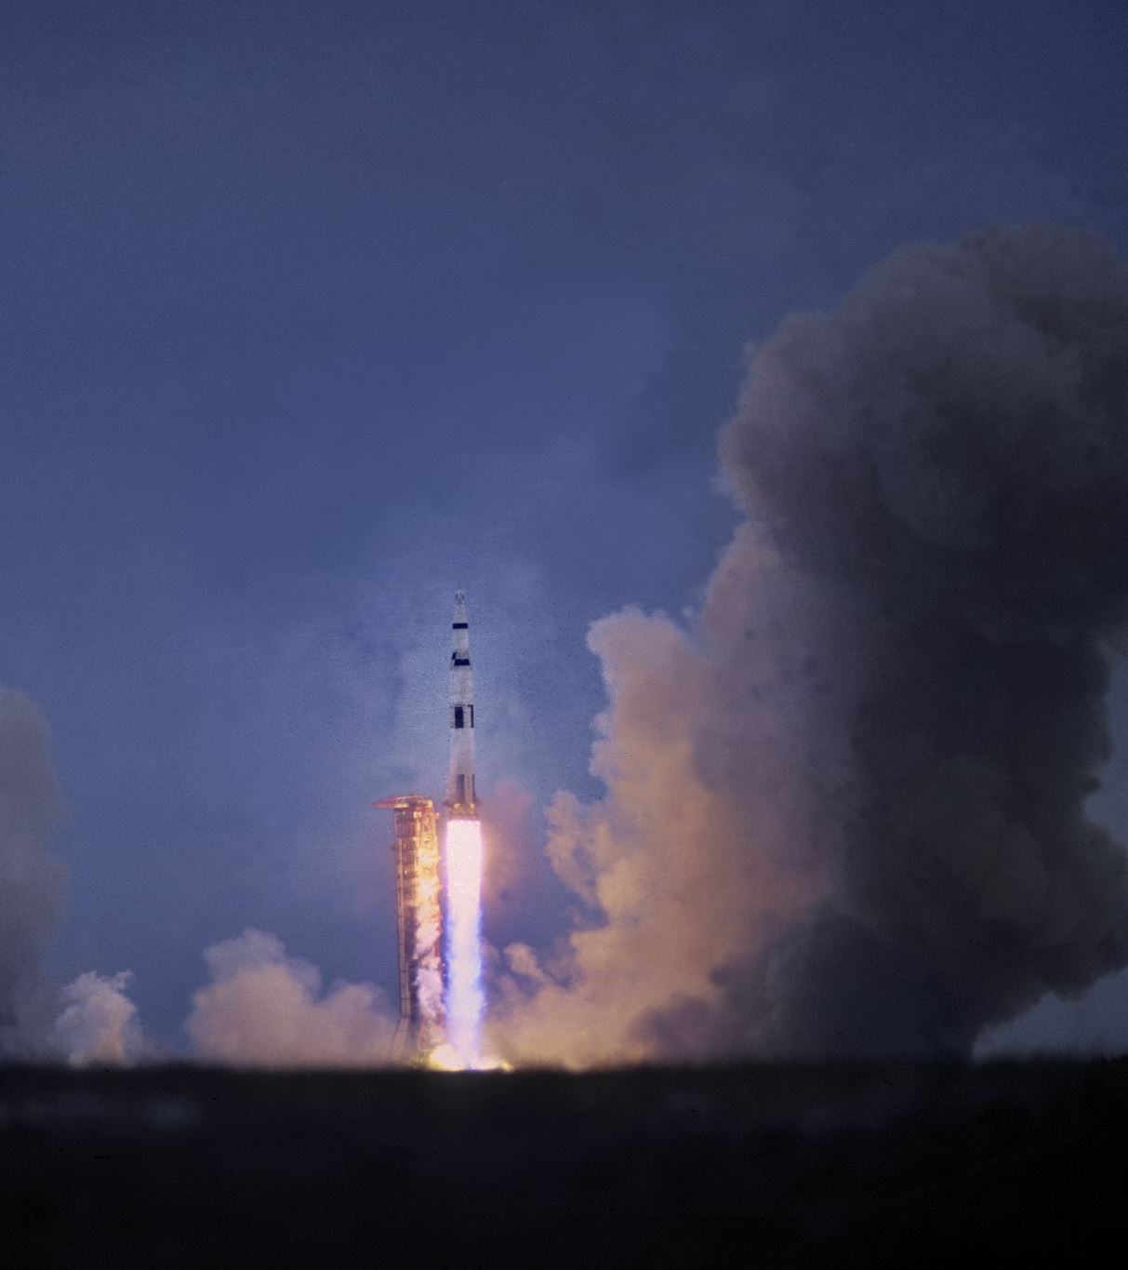
Background
Launch Vhicles rely on Thrust-Vector Contol (TVC) for pitch reliability during ascent.
Early ascent allows for reliable small-angle linearization which enables state-space control design.
Standard GN&C practice uses LQR, Pole Placement, and observers for attitude control.
The literature supports linear modeling near trim and validates robustness metrics here.

Slide 4


Problem Formulation
States: x = [θ q]^T, input u = δ (gimbal deflection), output y = θ.
Goal: To track small pitch commands with good damping and bounded actuator effort.
Linearized model about upright equilibrium.
Finalized State-Space Form
Integral Action added via the 3-state augmented system.

Slide 5
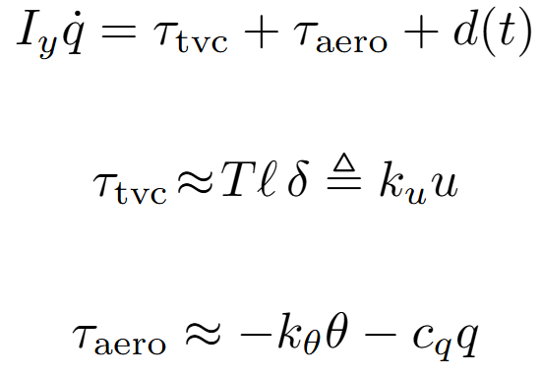
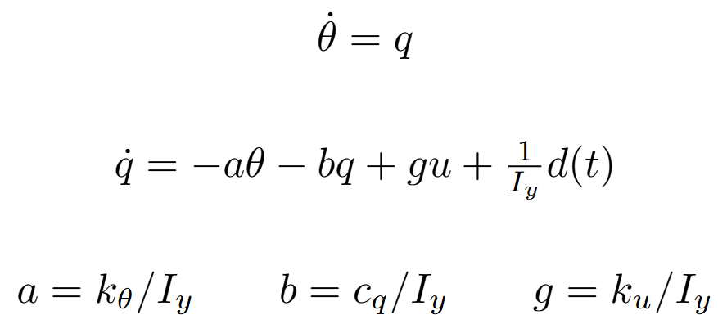
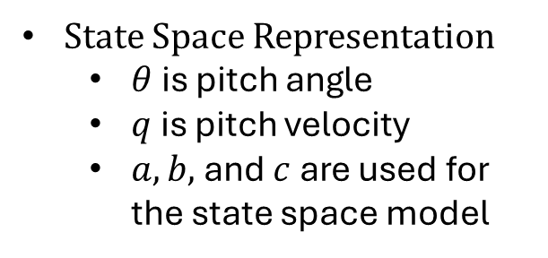
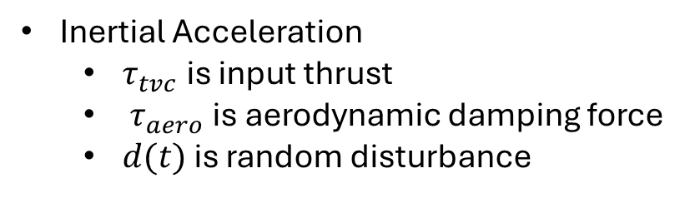
Mechanical and System Modeling
State Space Representation
$θ$ is pitch angle
$q$ is pitch velocity
$a, b,$ and $c$ are used for the state space model
Inertial Acceleration
$τ_{tvc}$ is input thrust
$τ_{aero}$ is aerodynamic damping force
$d(t)$ is random disturbance

Slide 6
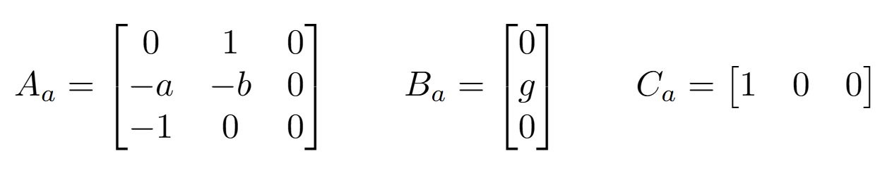
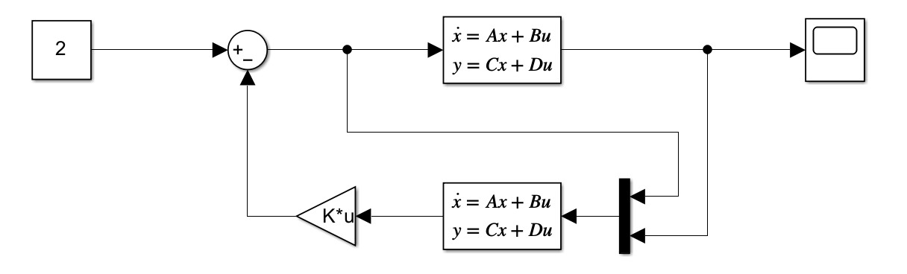
State Space Description

Slide 7
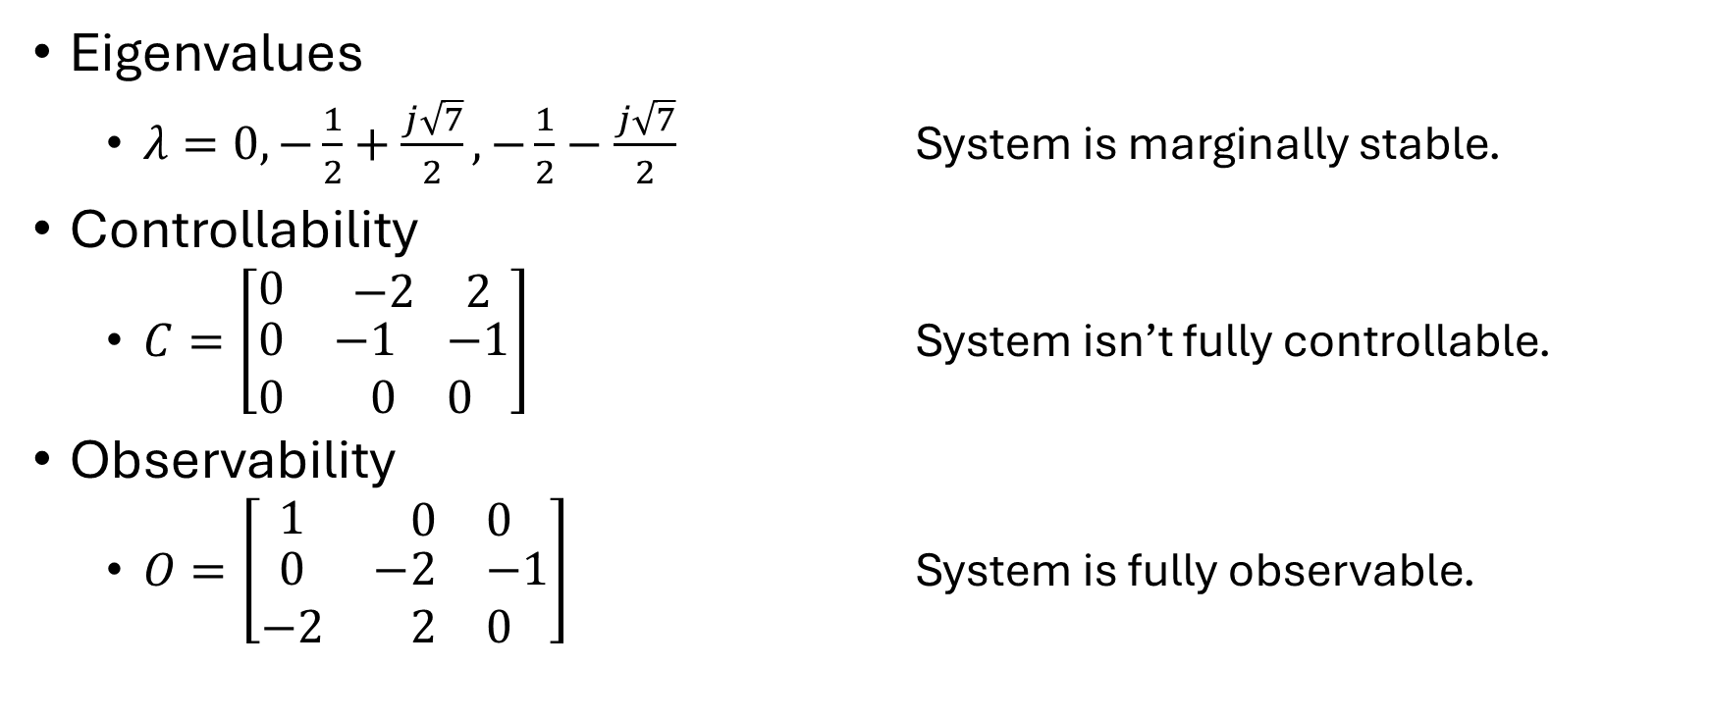
Open Loop System Analysis
Eigenvalues
$λ=0,−\frac{1}{2}+\frac{j\sqrt{7}}{2},−\frac{1}{2}−\frac{j\sqrt{7}}{2}$ System is marginally stable.
Controllability
$C=\left[\begin{matrix}0 & \begin{matrix}−2 & 2\end{matrix} \\ \begin{matrix}0 \\ 0\end{matrix} & \begin{matrix}\begin{matrix}−1 & −1\end{matrix} \\ \begin{matrix}0 & 0\end{matrix}\end{matrix}\end{matrix}\right]$ System isn’t fully controllable.
Observability
$O=\left[\begin{matrix}1 & \begin{matrix}0 & 0\end{matrix} \\ \begin{matrix}0 \\ −2\end{matrix} & \begin{matrix}\begin{matrix}−2 & −1\end{matrix} \\ \begin{matrix}2 & 0\end{matrix}\end{matrix}\end{matrix}\right]$ System is fully observable.

Slide 8
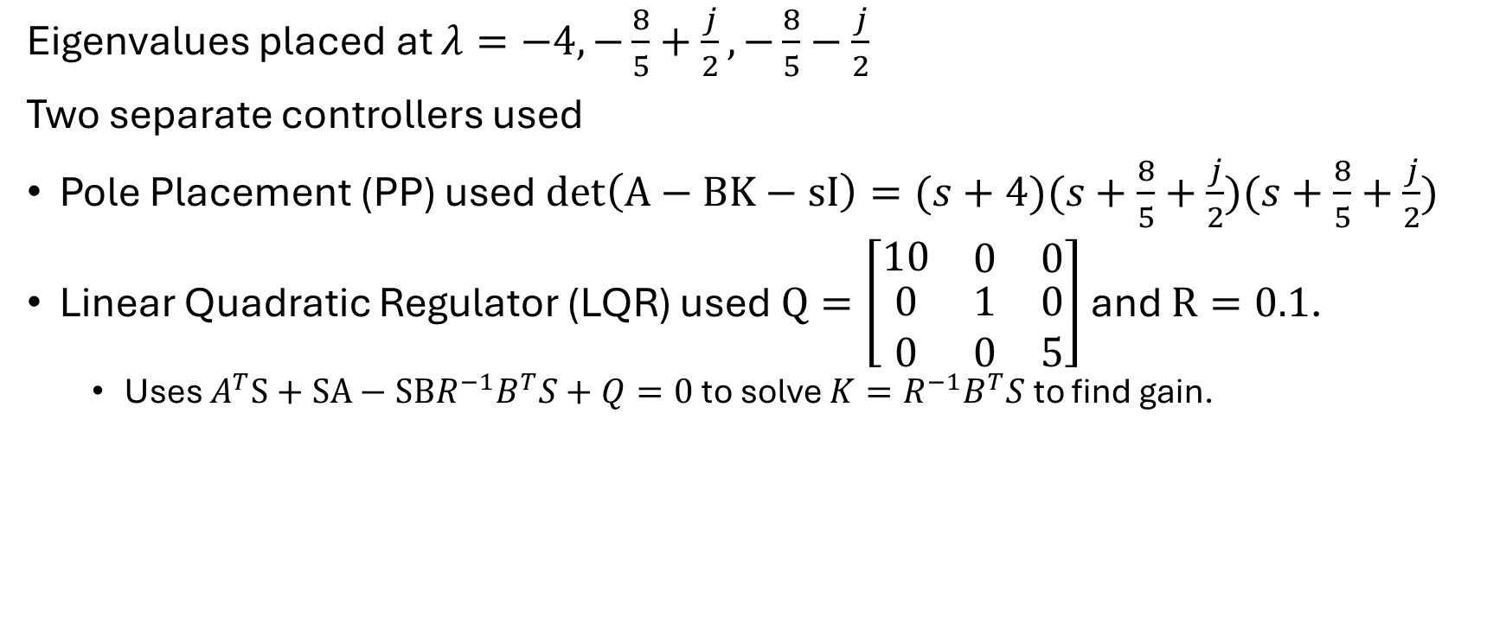
System Controller
Eigenvalues placed at $λ=−4,−\frac{8}{5}+\frac{j}{2},−\frac{8}{5}−\frac{j}{2}$
Two separate controllers used
Pole Placement (PP) used $det\left(A−BK−sI\right)=(s+4)(s+\frac{8}{5}+\frac{j}{2})(s+\frac{8}{5}+\frac{j}{2})$
Linear Quadratic Regulator (LQR) used $Q=\left[\begin{matrix}10 & \begin{matrix}0 & 0\end{matrix} \\ \begin{matrix}0 \\ 0\end{matrix} & \begin{matrix}\begin{matrix}1 & 0\end{matrix} \\ \begin{matrix}0 & 5\end{matrix}\end{matrix}\end{matrix}\right]$ and $R=0.1$.
Uses $A^{T}S+SA−SBR^{−1}B^{T}S+Q=0$ to solve ${K=R}^{−1}B^{T}S$ to find gain.

Slide 9
Results Overview
Each experiment tests LQR and PP controller.
Experiment 1
The closed loop system properly tracks the input.
Experiment 2
The closed loop system properly tracks a larger input.
Experiment 3
The closed loop system properly stabilizes after a disturbance.
Experiment 4
The closed loop system tracks under slightly different shifted variables.

Slide 10
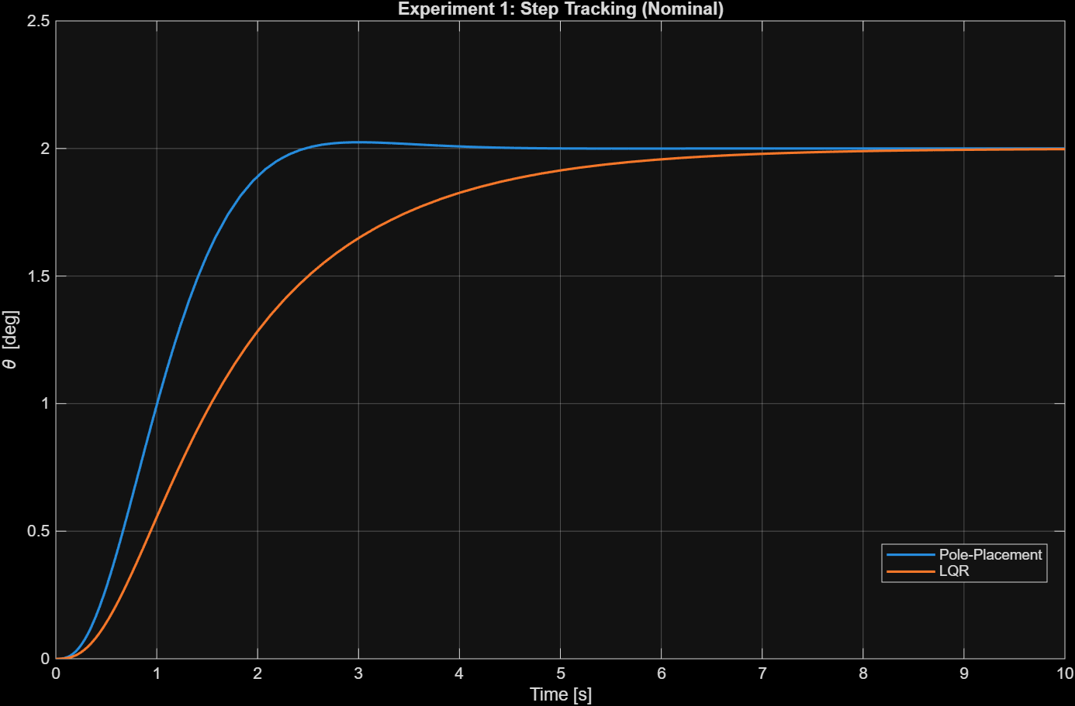
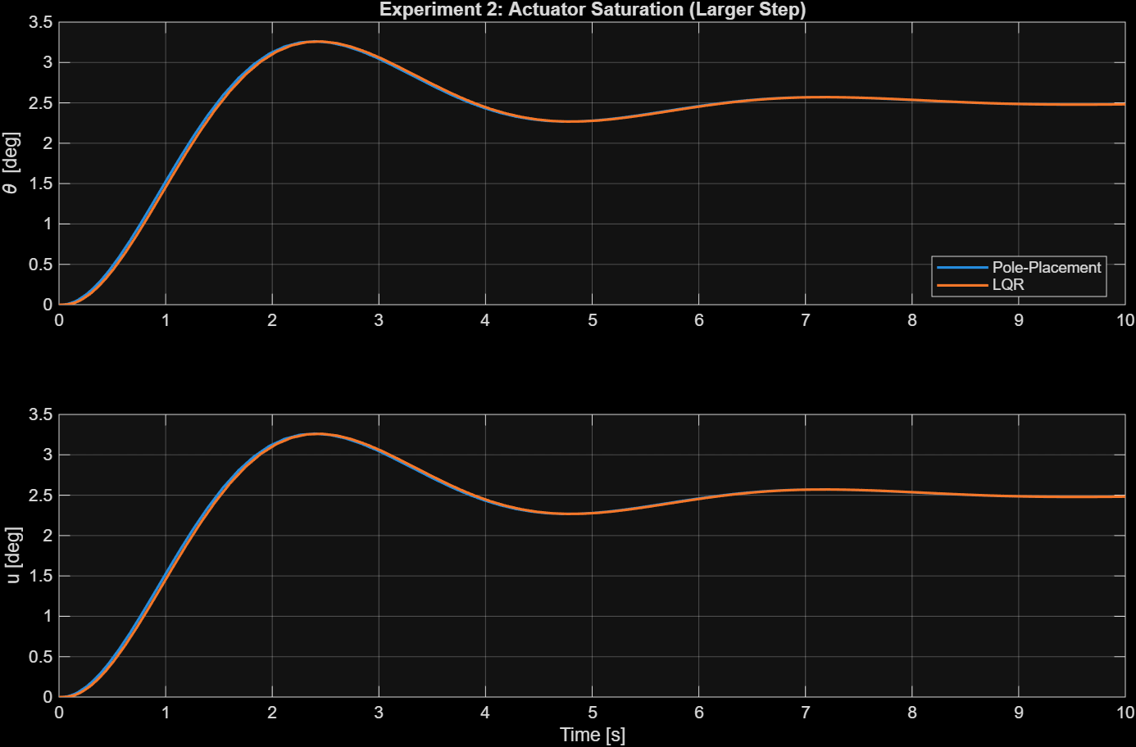
Results

Slide 11
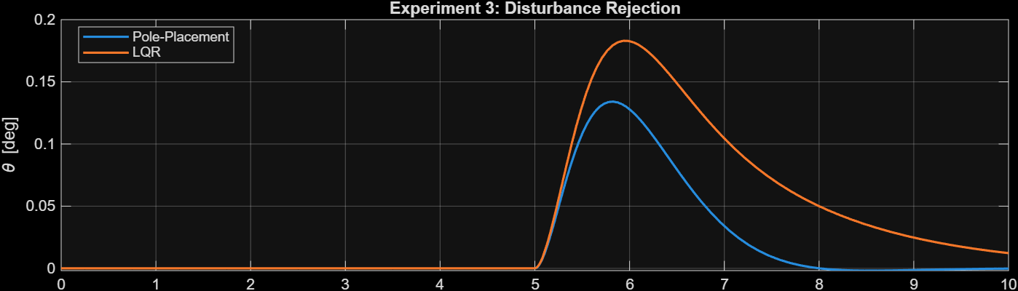
Results

Slide 12
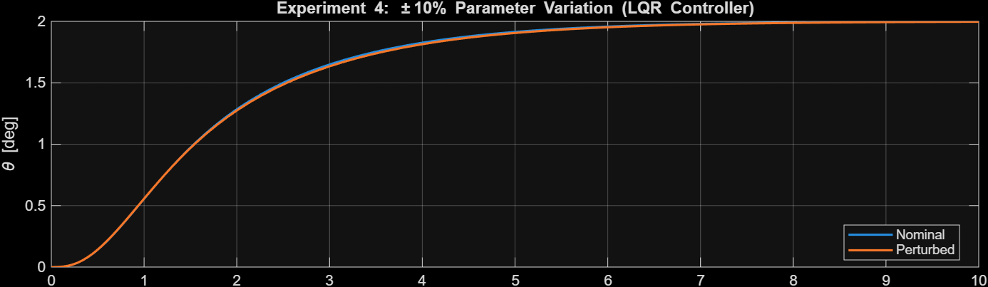
Results

Slide 13
Conclusions
Linearized Pitch-Axis Model is derived from Newton-Euler dynamics with small-angle TVC moment approximation.
Controllability, obsevability, and eigenstructure validated feasibility of state-space control and estimation.
Pole-Placement and LQR controllers implemented using the integral-augmented model to eliminate steady-state error.
Simulations confirmed robustness across step-tracking, saturation, disturbance, and +/- 10% parameter variation.

Slide 14
Bibliography
C. J. Dennehy, R. Lanzi, and P. Ward, “GN&C design overview and flight test results from NASA’s max launch abort system (MLAS),” in AIAA Guidance, Navigation, and Control Conference, NASA NTRS 20110000768, 2010.
B. Stuart, J. McEnulty, J. Wall, J. Orr, and P. Pektas, “Overview of the SLS core stage thrust vector control system design,” in AAS Guidance, Navigation and Control Conference, NASA NTRS 20230001023, 2023.
J. S. Orr and J. W. Wall, “Linear approximation to optimal control allocation for rocket nozzles with elliptical constraints,” in AIAA Guidance, Navigation, and Control Conference, NASA NTRS 20110015708, 2011. DOI: 10.2514/6.2011-6500.
J. Borsody and F. Teren, “Stability analysis and minimum thrust vector control requirements of booster vehicles during atmospheric flight,” NASA, Tech. Rep. NASA TN D-4593, 1968.
M. Athans, “The role and use of the stochastic linear- quadratic-gaussian problem in control system design,” IEEE Transactions on Automatic Control, vol. AC-16, no. 6, pp. 529–552, 1971.
D. G. Luenberger, “Observers for multivariable systems,” IEEE Transactions on Automatic Control, vol. AC-11, no. 2, pp. 190–197, 1966. DOI: 10.1109/ TAC.1966.1098323.
T. Claggett and M. Langehough, “Application of integral-LQ to launch vehicle autopilot design,” in AIAA Guidance, Navigation, and Control Conference, 1989. DOI: 10.2514/6.1989-3459.
P. dos Santos and P. Oliveira, “Integrated architecture for navigation and attitude control of low-cost suborbital launch vehicles,” Acta Astronautica, vol. 222, pp. 52– 68, 2024. DOI: 10.1016/j.actaastro.2024.05.039.
G. Di Mauro, M. Lawn, and R. Bevilacqua, “Survey on guidance, navigation and control requirements for spacecraft formation-flying missions,” Journal of Guidance, Control, and Dynamics, vol. 41, no. 3, pp. 581– 602, 2018. DOI: 10.2514/1.G002868.

Slide 15
Bibliography
C. J. Dennehy, R. Lanzi, and P. Ward, “GN&C design overview and flight test results from NASA’s max launch abort system (MLAS),” in AIAA Guidance, Navigation, and Control Conference, NASA NTRS 20110000768, 2010.
M. Levy, T. Shima, and S. Gutman, “Integrated single vs. two-loop autopilot-guidance design for dual- controlled missiles,” in 2013 10th IEEE International Conference on Control and Automation (ICCA), Hangzhou, China, 2013, pp. 1730–1735. DOI: 10.1109/ ICCA.2013.6564961.
B. L. Stevens, F. L. Lewis, and E. N. Johnson, Aircraft Control and Simulation: Dynamics, Controls Design, and Autonomous Systems, 3rd ed. Wiley, 2015.
M. V. Cook, Flight Dynamics Principles: A Linear Systems Approach to Aircraft Stability and Control, 3rd ed. Oxford: Butterworth-Heinemann, 2013, ISBN: 978-0-08-098242-7.
I. Papp, “Missile mathematical model and system design,” AARMS, vol. 16, no. 1, pp. 29–35, 2017. DOI: 10.32565/aarms.2017.1.3.
A. B. Kisabo, F. A. Aliyu, O. C. Okwo, and S. O. Samuel, “State-space modelling of a rocket for optimal control system design,” Journal of Aircraft and Spacecraft Technology, vol. 3, pp. 128–137, 2019. DOI: 10. 3844/jastsp.2019.128.137.
C.-T. Chen, Linear System Theory and Design, 4th ed. Oxford: Oxford University Press, 2013, ISBN: 9780199964543.

Slide 16

Questions?

Slide 17
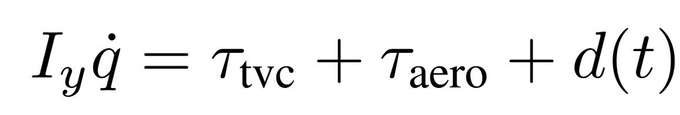
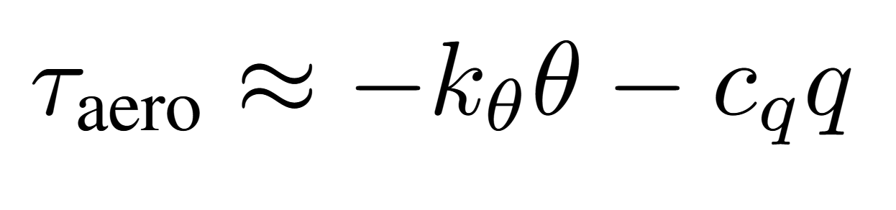


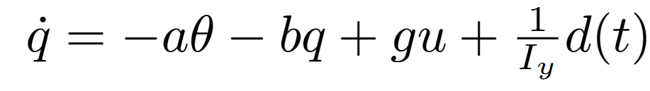
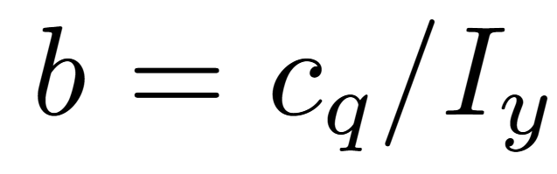
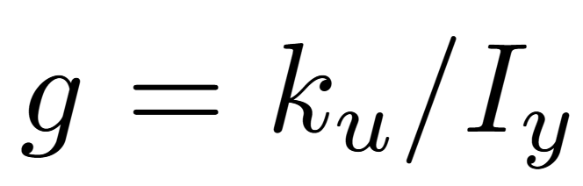
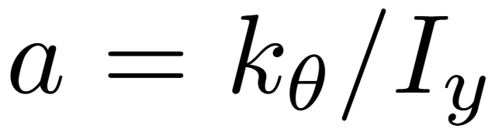
Individual Equations

